Slide 1
Major Project
Submitted by: Pranzal sharma (PIET20CS137)

Slide 2
What is a Blog
A blog, short for "weblog," is a type of website or online platform where individuals or organizations regularly publish written content, often in a journal-style format, on various topics. Blogs serve as a platform for sharing information, expressing opinions, telling stories, and engaging with a target audience.

Slide 3
WordPress Blog Website
WordPress is a versatile and widely-used content management system (CMS) that empowers bloggers to create, manage, and customize their websites with ease. It's particularly renowned for its blog-centric capabilities.
With a user-friendly interface, bloggers can effortlessly compose, edit, and categorize their posts, while the vast library of themes and plugins offers ample room for customization, ensuring that your blog reflects your unique style and branding.
WordPress's SEO-friendly architecture aids in optimizing content for search engines, and its responsive design ensures that your blog looks great on any device. From handling media files to engaging with your audience through comments and social media integration, WordPress provides a comprehensive suite of tools. Furthermore, it adapts to the blogger's growth, supporting everything from small personal blogs to large news websites and online stores.

Slide 4
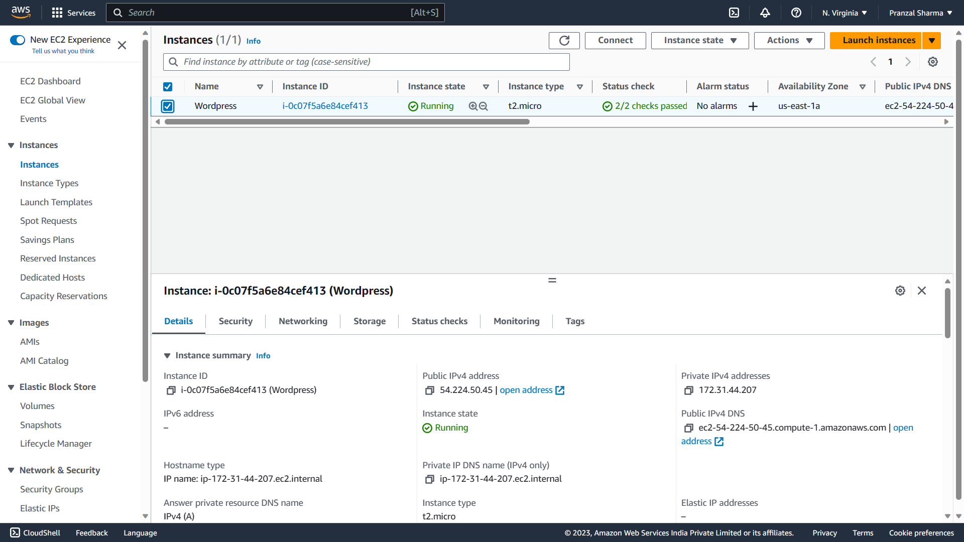
Server hosting through AWS:

Slide 5
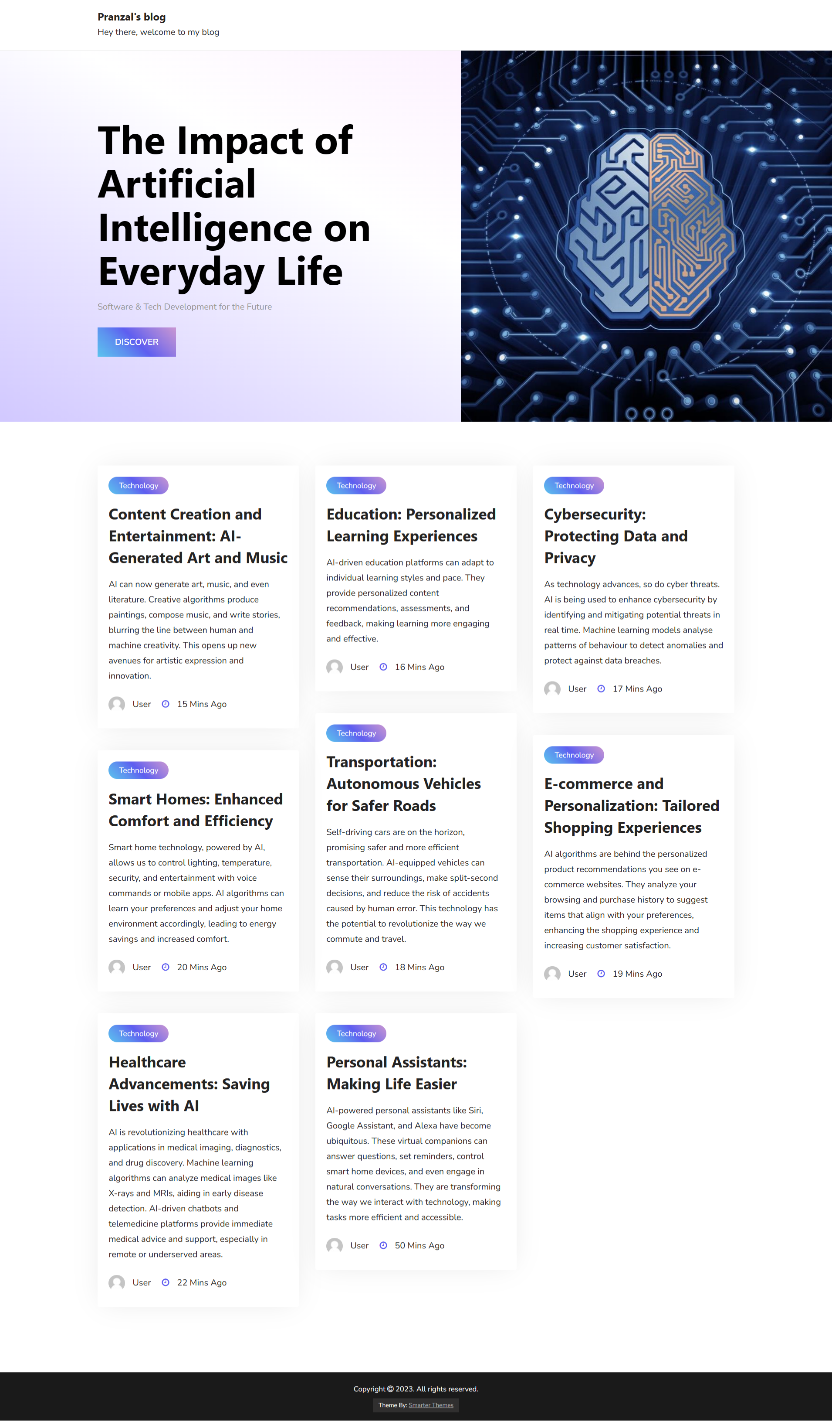
Blog page:

Slide 6
THANK YOU

